Slide 1
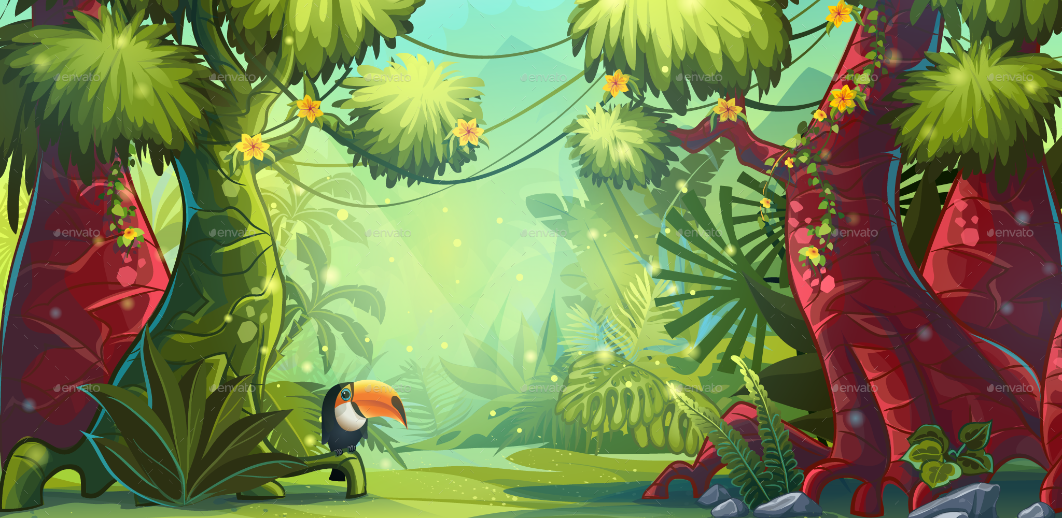
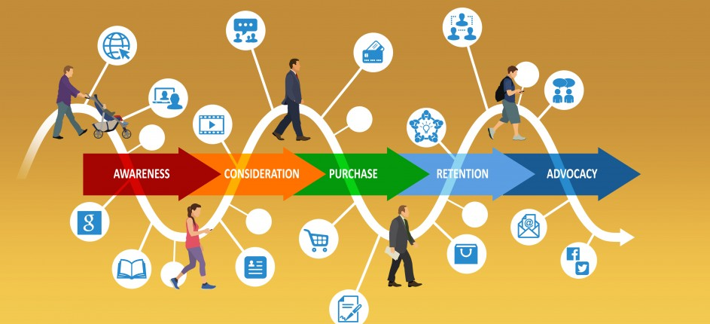
CUSTOMER JOURNEY OF SHARON & THOMAS

Slide 2
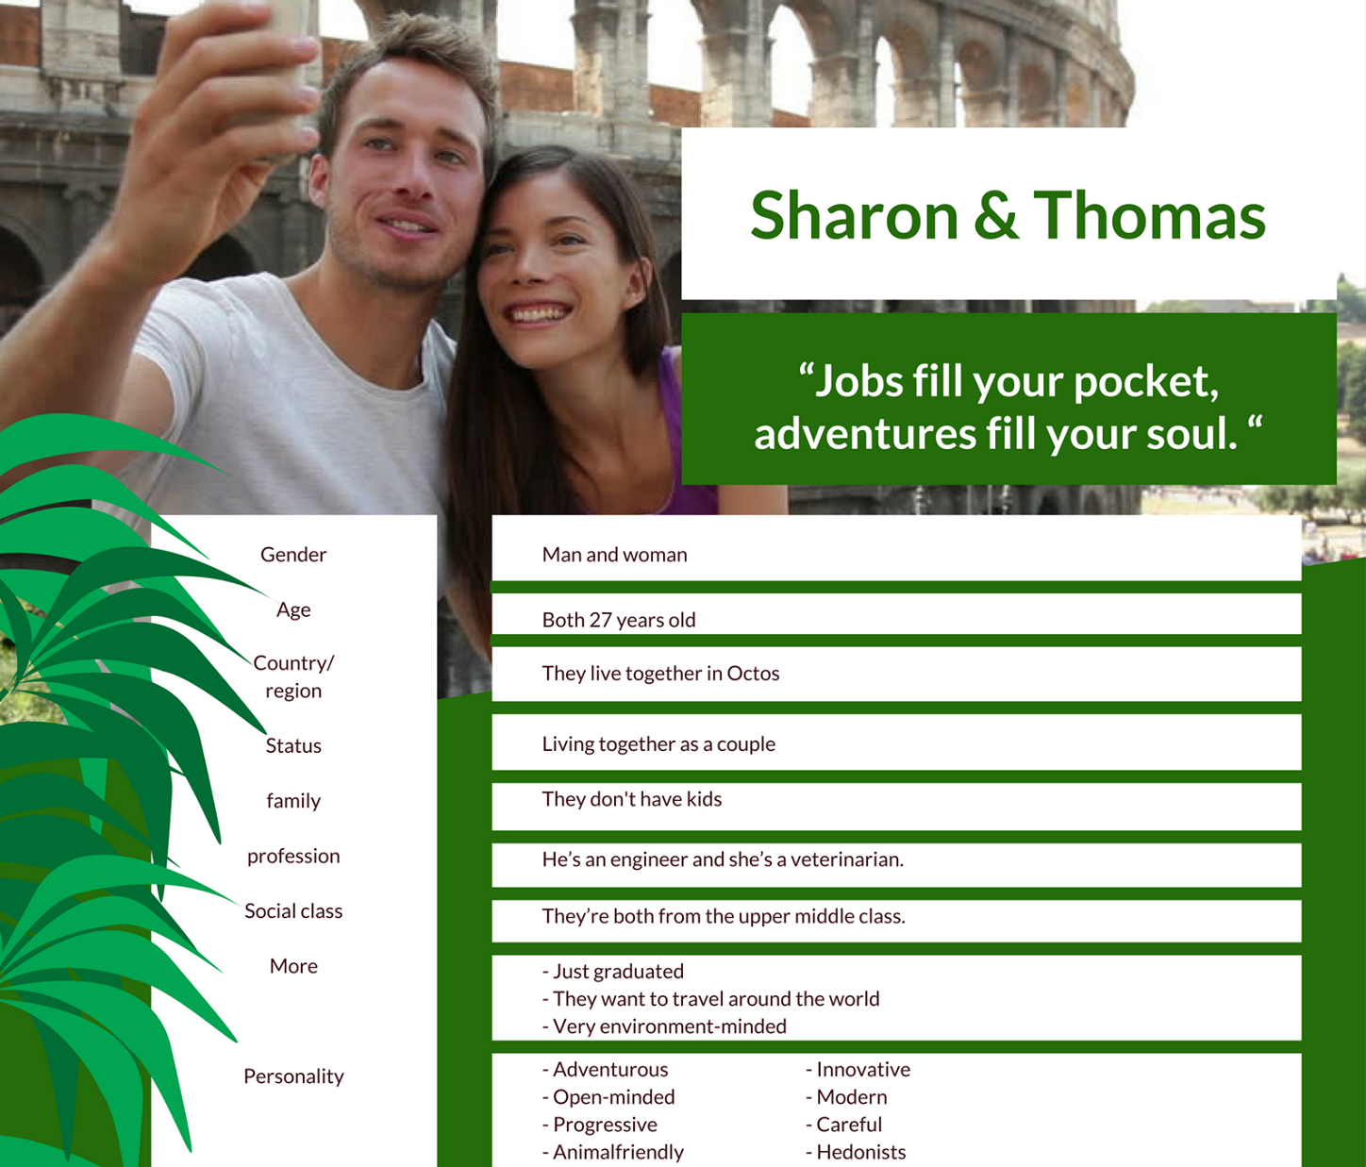

Slide 3

AWARENESS
When she was still at school, a teacher told Sharon about the ZOOWORLD project. She remembers that one of her friends went to Baboonia on Erasmus and that she was extremely positive about the Baboonian people.
Touchpoint 1 ---> Word-of-mouth

Slide 4
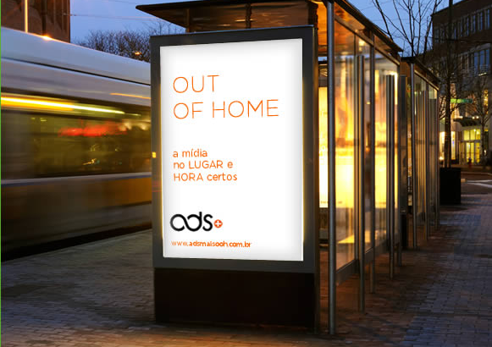
AWARENESS
Every time the couple goes scuba diving, they pass a bus stop with an advertisement for ZOOWORLD.
Touchpoint 2 ---> Outdoor

Slide 5
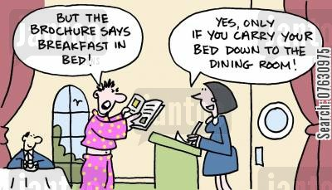
AWARENESS
Thomas is working on a project at the Baboonian embassy. When he entered this embassy for the first time, he saw the beautiful brochure and he decided to take one.
Touchpoint 3 ---> Print

Slide 6

CONSIDERATION
The couple decides to look for information on the Facebook page, on the website and search for reviews on TripAdvisor.com
Touchpoint 4 ---> Social media, website, 3rd party sites..

Slide 7
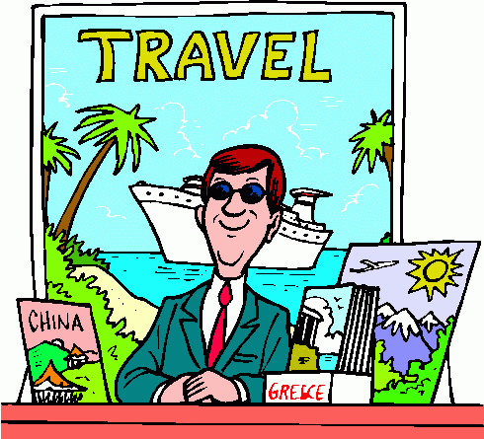
PURCHASE
The couple goes to the travel agency and book a trip to Baboonia. Afterwards, they book the jeep & sleep tours online.
Touchpoint 5 ---> Website, travel agent

Slide 8

SERVICE
If Sharon and Thomas have any questions, they can send mails or call the call center for tourists. They can also follow Baboonia, ZOOWORLD, the jeep & sleep tours on social media or visit the website.
Touchpoint 6 ---> call center, direct mail, social media, website..

Slide 9
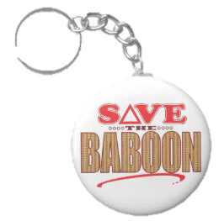
LOYALTY EXPANSION
After their trip, they get a key ring of a baboon as a souvenir. We also ask the guests to fill in a survey, in order to improve our tourist offers. Anyone who adopts an animal of ZOOWORLD, gets a mail with a picture and an update every month.
Touchpoint 7 ---> souvenir, survey, mailings

